Slide 1
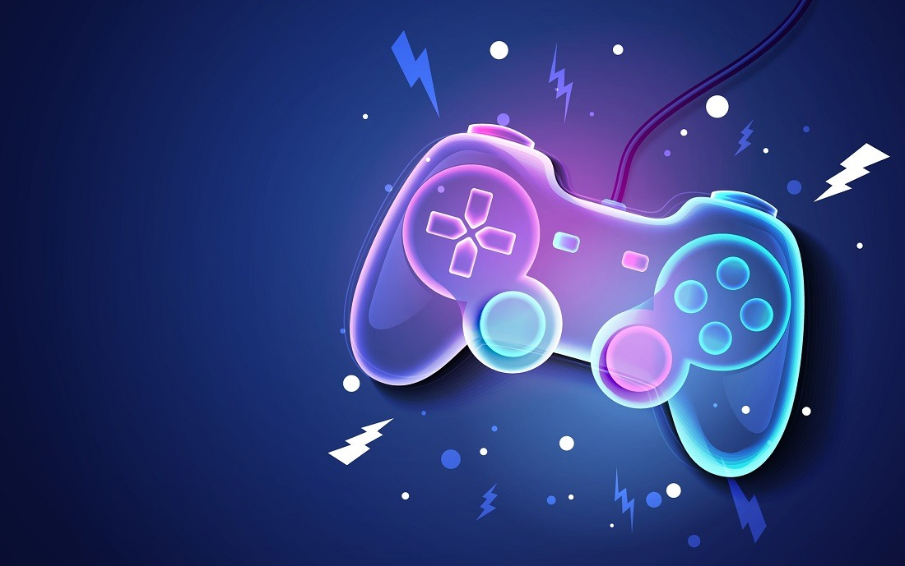
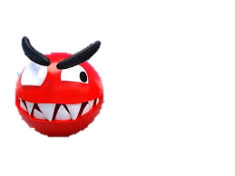
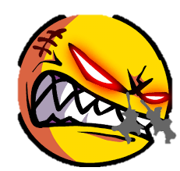

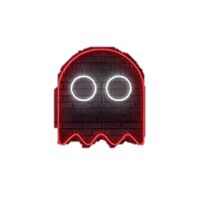


Digital Dreams 2D
The
PAC-MANS
A Fun Multiplayer game Between two Pac-men.
Best to Play with friends.

Slide 2

Objectives
Main term That will be discussed
Sprites
Major
Points
Conditions
Strategies

Slide 3
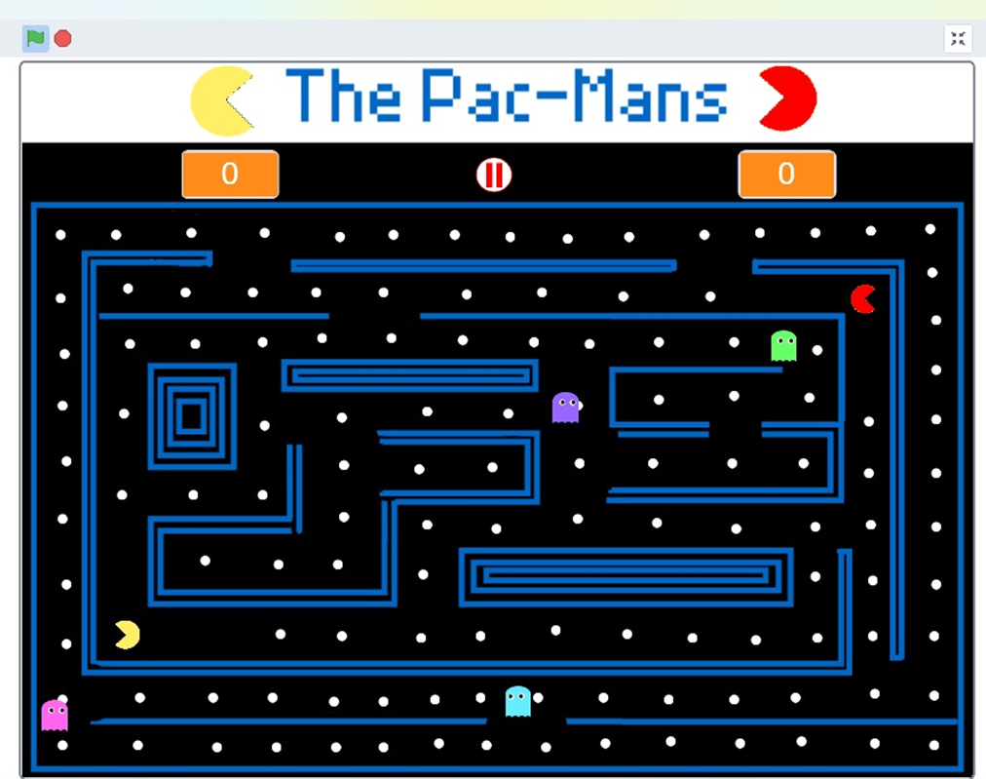
Game Idea:
The Pac-Mans is a classic arcade style game where Pac-man navigates through
a maze, eating pellets and avoiding ghosts.

Slide 4
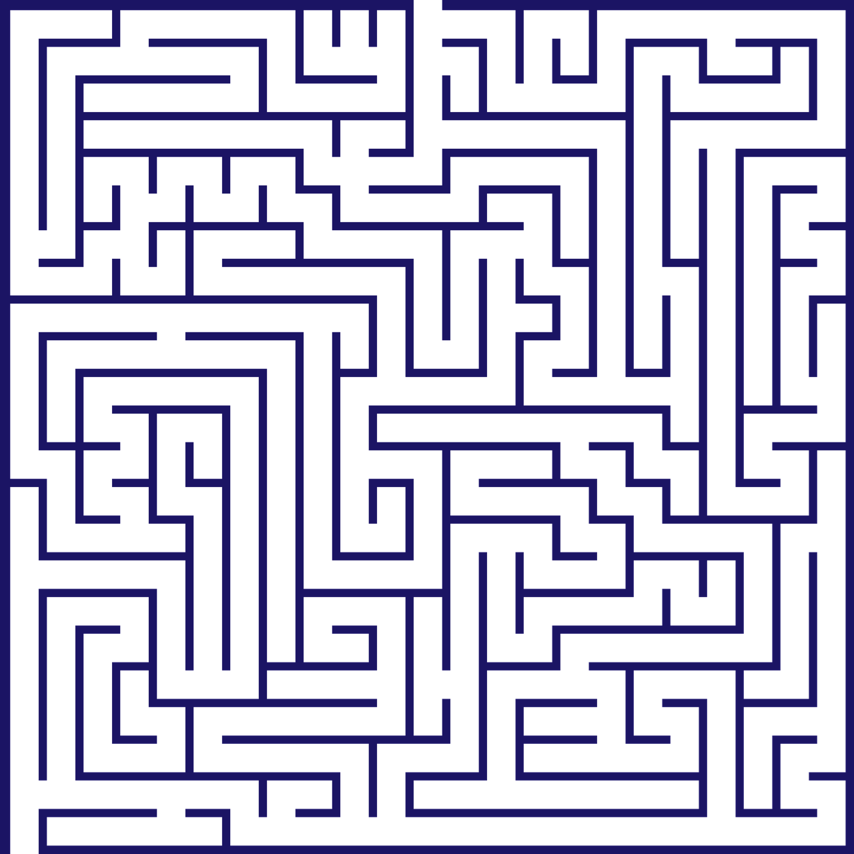
Main Sprites
MAZE
Maze is the Pac-man game area where ghost, Pac-mans and pellets are displayed..

Slide 5
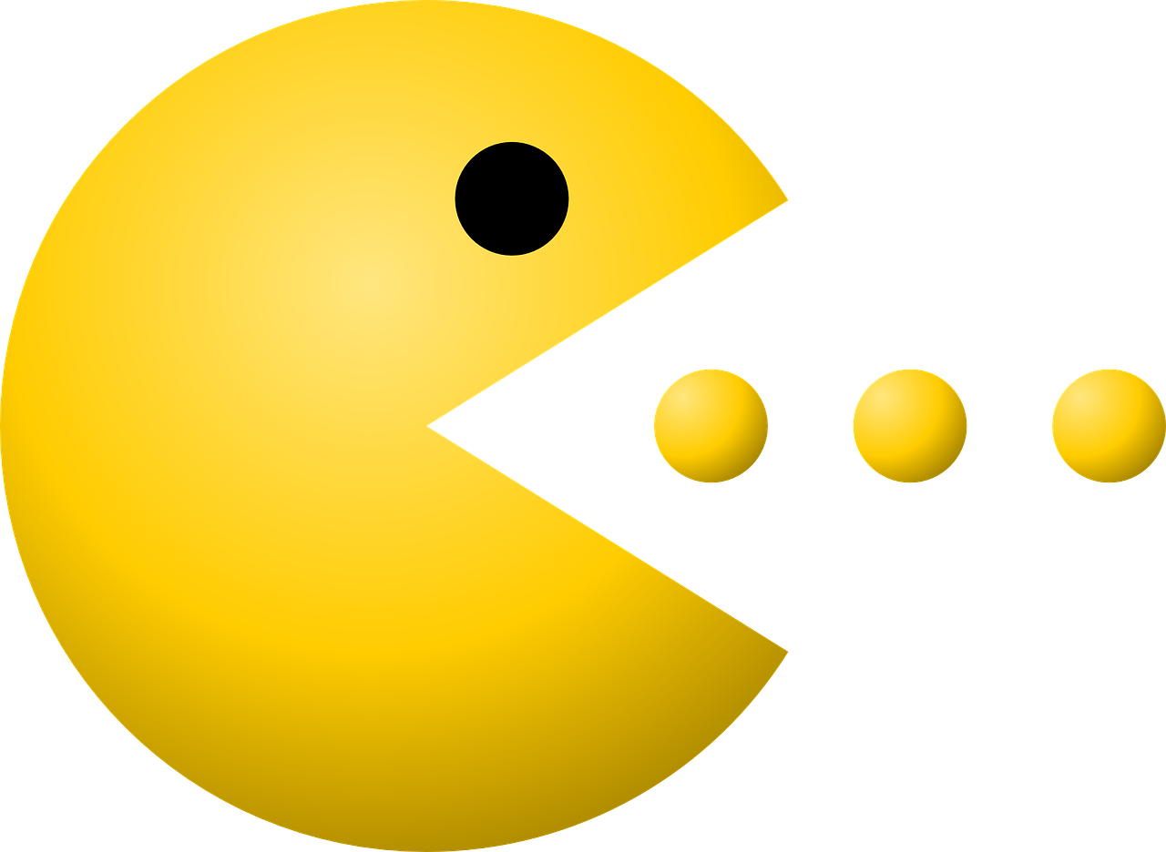
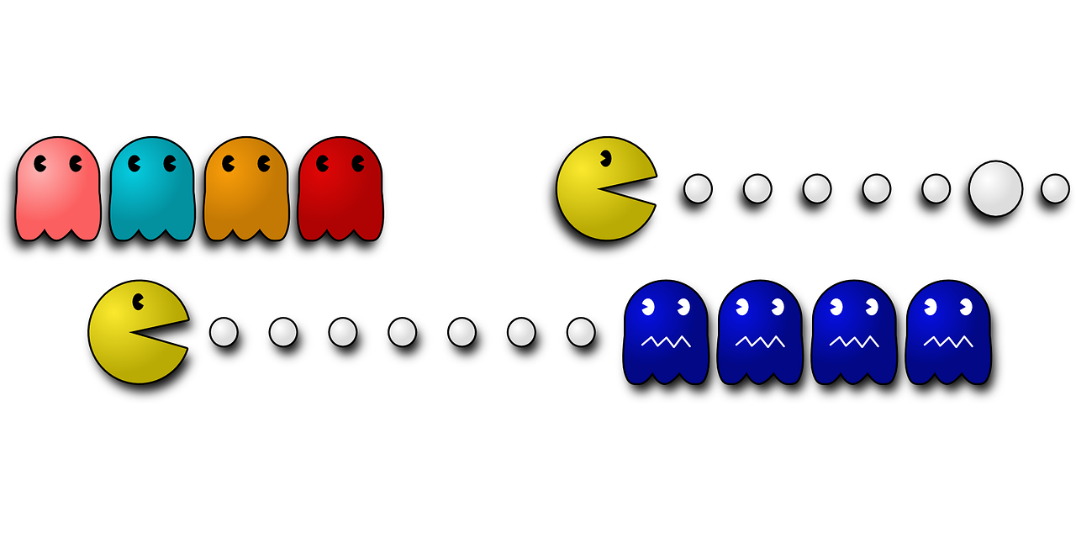
PAC MAN
Pac man is the main character of the game.
It works by opening and closing mouth. It eat pellets
Spread in the maze.

Slide 6
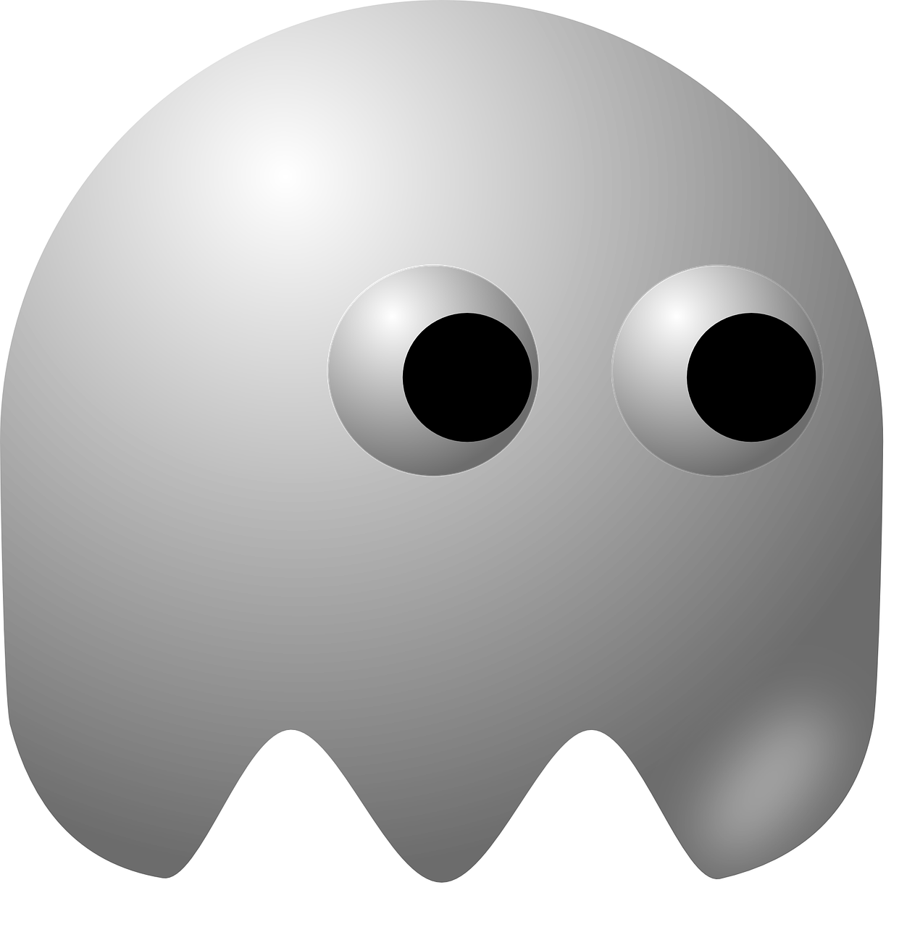
GHOST
Ghost is the villain of Pac man in the game. When ghost touches Pac man ,Pac Man disappears for 3.0 seconds and again appears at the starting point.

Slide 7
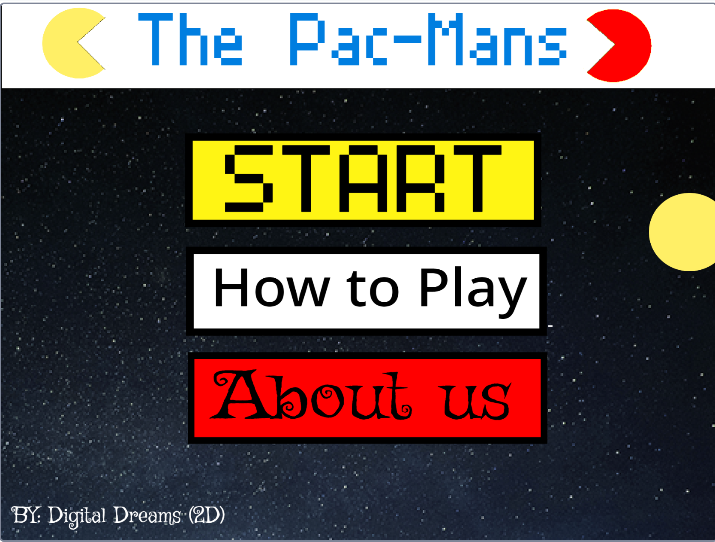



Special Purpose Sprites
This Sprite is Used to the Game. When we Press this button the Level Backdrop appears
When we click this sprite The gameplay instructions are shown.
Clicking on this sprite provides you the information of our group and this project.

Slide 8
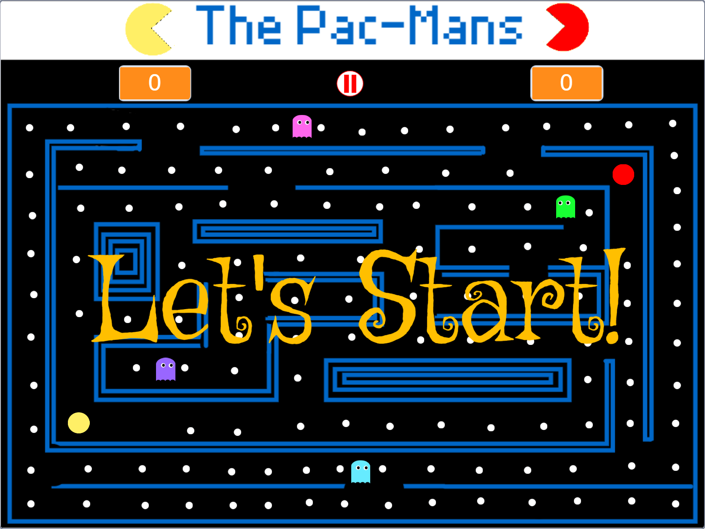


Continued…
This is a menu button. When the users want to leave the game they can click on this button to directly go to the Menu Backdrop
The last Special purpose Sprite is a play again sprite. After Finishing the Game the users can click on this button to play the game again,

Slide 9

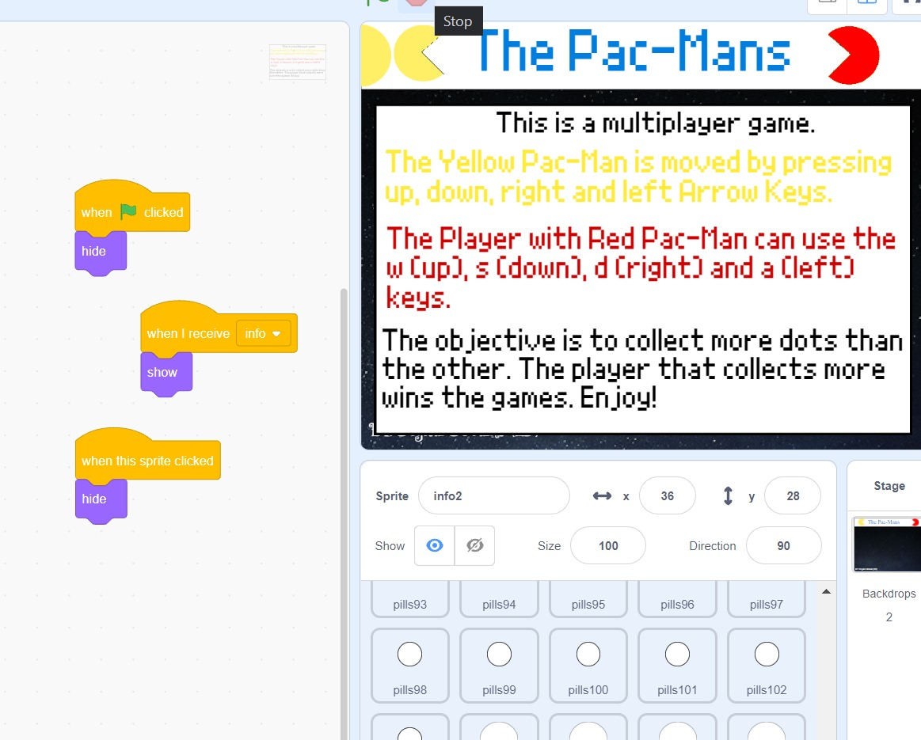

Slide 10
Winning and losing conditions
If Yellow Pac-man eats more pellets than the red Pac-man, the Yellow Pac-man will be the winner and a congratulations message appears on the screen.
If Red Pac-man eats more pellets than the yellow Pac-man, the Red Pac-man will be the winner and a congratulations message appears on the screen.

Slide 11
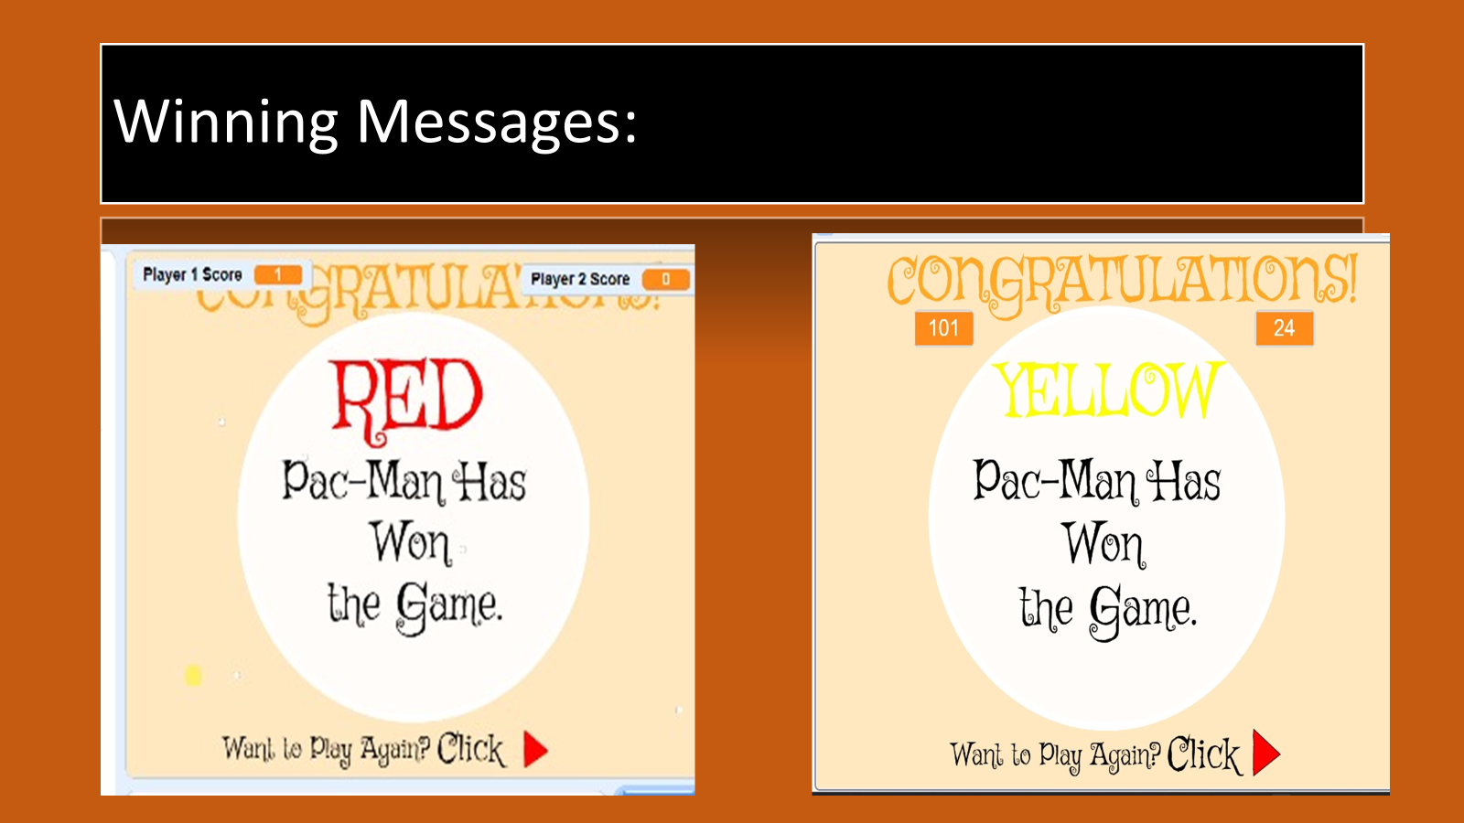


Slide 12
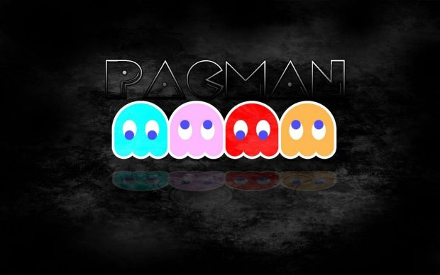
THANK YOU

